Slide 1

SWIFTTOLL
A GPS-DRIVEN SMART TOLL PAYMENT AND ROUTE OPTIMIZATION SYSTEM FOR SEAMLESS HIGHWAY TRAVEL

Slide 2

OBJECTIVES
•Enable seamless, cashless toll transactions through GPS-based tracking.
•Use real-time geofencing and AI-based license plate recognition instead of RFID tags.
•Ensure quick vehicle clearance at toll gates to minimize waiting time.
•Enhance Security & Prevent Toll Evasion by integrating AI-based vehicle verification and geofencing alerts to ensure only paid vehicles pass through.
•Utilize low-cost IoT and AI instead of expensive hardware solutions.

Slide 3
EXISTING SYSTEM
1.Manual Toll Collection:
Vehicles stop at toll booths where cash payments are made.
Time-consuming, leading to congestion.
Prone to human errors and fraud.
2.ANPR (Automatic Number Plate Recognition) Based Systems:
Uses cameras with OCR (Optical Character Recognition) to read license plates.
No RFID tags needed, but:
Requires high-quality cameras and cloud processing.
Errors in plate recognition can lead to wrong toll charges.

Slide 4
EXISTING SYSTEM
(cont..)
3.RFID-Based Toll Collection (FASTag in India, EZPass in the US, etc.):
Uses RFID tags attached to vehicles and linked to bank accounts.
Vehicles pass through RFID scanners, and toll amounts are deducted automatically.
Faster than manual tolls, but has limitations:
4.GPS-Based Tolling (Used in Some European Countries):
Vehicles with onboard GPS trackers are charged automatically based on distance traveled.
Efficient, but requires government-backed infrastructure and universal GPS adoption.

Slide 5
PROPOSED SYSTEM
How our System Works?
Uses GPS-based geofencing to detect when a vehicle enters or exits a toll zone.
Real-time license plate recognition (AI-powered) ensures secure toll transactions.
Automatic bank account deductions or wallet payments.
Integrates IoT & AI to remove RFID dependency.
Toll gates open automatically upon verified payment confirmation.

Slide 6
COMPONENTS USED
1.ESP8266 WiFi Module
Acts as the core communication unit in the system.
Connects to the cloud/server to send and receive toll transaction data.
Helps authenticate vehicle entry/exit in the geofenced toll zone.
2.Servo SG90 Motor
Controls the physical toll gate mechanism if needed.
Opens and closes the toll barrier automatically upon successful payment verification.
Ensures seamless vehicle movement through toll booths without human intervention

Slide 7
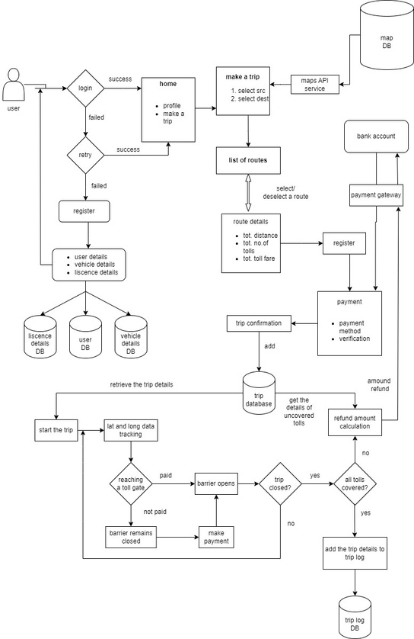
DESIGN METHODOLOGY

